Slide 1
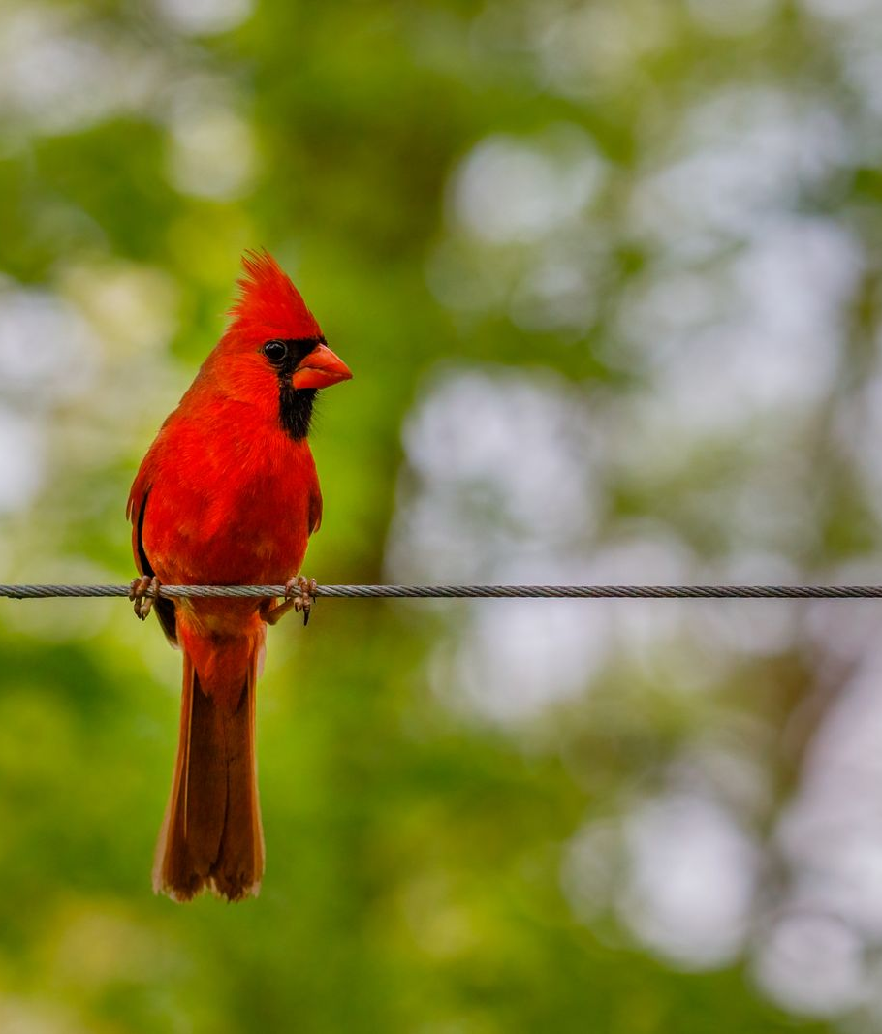
A CASUAL SPECIES LOG, 2025
A Year at the Backyard Feeder
Counting the regulars at 327 Munroe Court. Juan Hernandez.

Slide 2
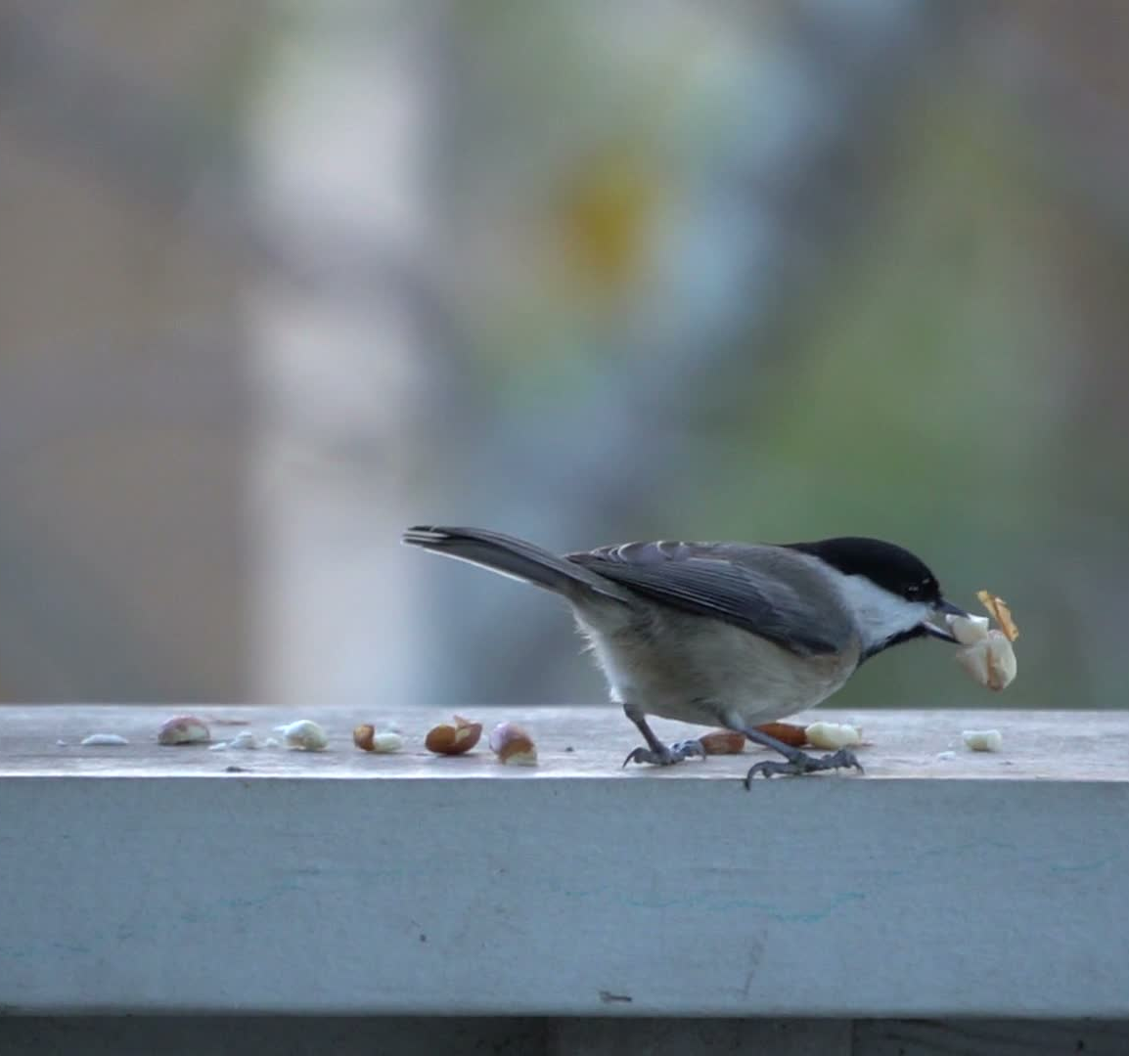
The feeder and the yard
1
• One mature oak, the old garden beds, and three feeders.
• A platform, a tube for sunflower and thistle, and a suet cage.
• Ten species turn up reliably across the year.
• Goldfinches peak in spring at the thistle.
• The first Carolina wren nested in the shed this year.
A Carolina chickadee at the rail.
A year at the backyard feeder - 327 Munroe Court, Annapolis

Slide 3
Peak counts by season
2
Counts are the season high for each species at the feeders.

Slide 4
The regulars, at a glance
3
Species | Winter | Spring | Summer | Fall | Year high
American goldfinch | 6 | 8 | 4 | 7 | 8
Northern cardinal | 4 | 6 | 5 | 5 | 6
Mourning dove | 5 | 4 | 4 | 6 | 6
House finch | 4 | 5 | 3 | 4 | 5
Carolina chickadee | 3 | 4 | 4 | 3 | 4
Blue jay | 2 | 2 | 3 | 4 | 4
Ten distinct species logged across the year. Full running list kept in my records app.
A year at the backyard feeder - 327 Munroe Court, Annapolis

Slide 5
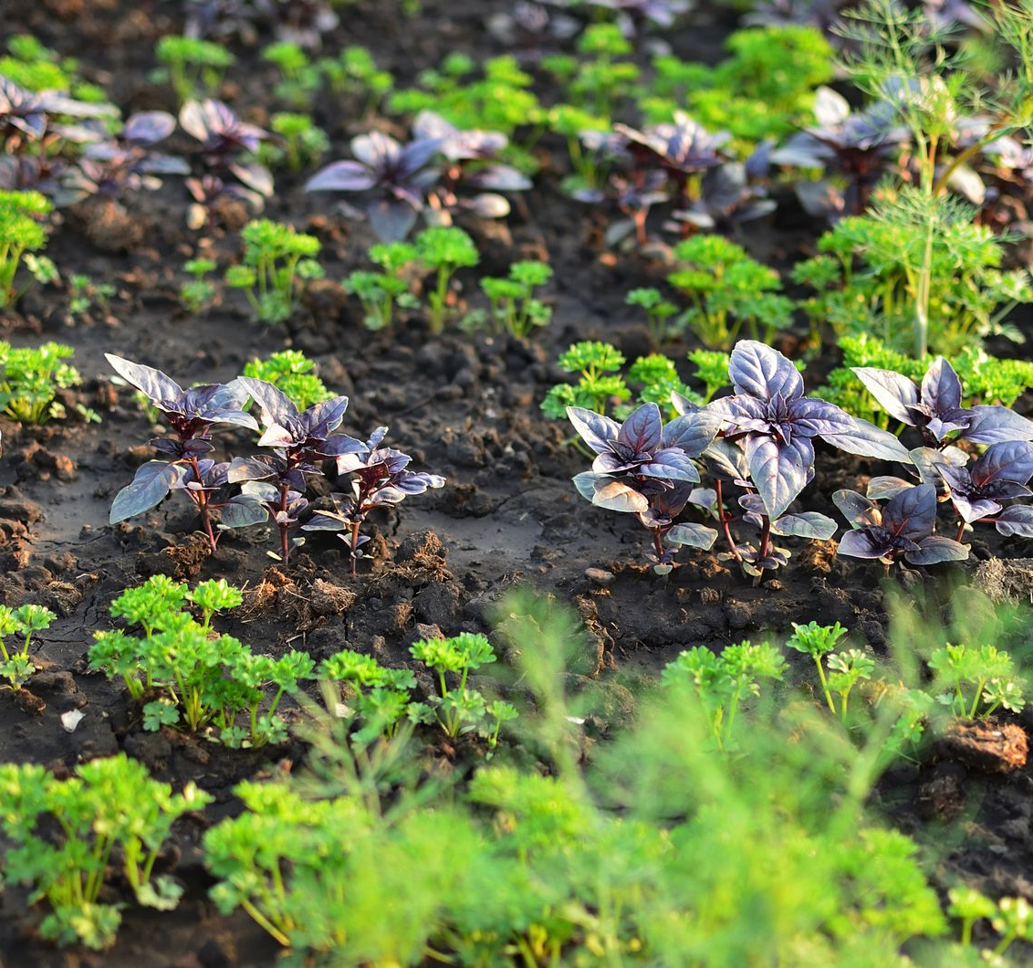
Notes for next year
4
• Add a second thistle feeder for the spring goldfinch rush.
• Move the suet higher on the oak after the jays cleared it out.
• Keep the ground tidy under the platform to discourage rodents.
• Photograph the wren nest if it returns to the shed.
Small changes at the feeder for the coming year.

